Slide 1
Test Readiness Review
CubeSat | Control
MECH/ECE 4010 – Product Design II
28 Feb 2025
Ben Sherman
Trace Shafer
Lauric Brown
Micah Gifford

Slide 2
Overview
Design Statement
Metrics Tests
Prototype Completion Check
Jigs & Fixtures
Detailed Test Plan
Calibration
Fabrication Plan
Bill of Materials
Budget
Schedule

Slide 3




Design Statement
Stakeholders: Utah NASA Space Grant Consortium, Utah Division of Water Resources
Sponsors: RAM, PTC, Washington County and Water Conservancy District
Design statement: Design, prototype, and evaluate attitude control system to point at a set location on Earth while taking a photo from low Earth orbit.
Notes:
Talking Points:
State who your sponsor is and give a short background
Read the design statement verbatim
Give the 1000-foot view of the project.

Slide 4
Metrics Tests
# | Metric | Description | Units | Acceptable Range | Planned Test
1 | Pointing Accuracy | How accurately the attitude and control can be maintained in a desired direction | rad | 0.00174533 to 0.0174533 | Spherical Bearing
2 | Rotate to Fix blur | The CubeSat will need to rotate while taking a picture to stop the blur | rad | 0.288 | Spherical Bearing
3 | Sun Sensor | Locates the sun and is required to back up star tracker (response time) | ms | <10 | Put it in the sun
4 | IMU | Tracks acceleration (accuracy) | Gravity force | -16 to 16 | Spherical Bearing (among others)
5 | Magnetometer | Range to cover earths magnetic field | microtesla | 20 to 10000 | Measure magnetic field in the room and cross-check it
6 | Magnetic dipole | Magnetorquers ability to create a magnetic dipole | Am^2 | 0.1 to 10 | Spherical Bearing
7 | FOV | Star Tracker camera | deg | 40 | Ceiling calibration
8 | Weight | Total Contingency Weight | g | 752.64 | Scale

Slide 5
Metrics Tests
# | Metric | Description | Units | Acceptable Range | Planned Test
9 | Rotating Accuracy | How accurately the CubeSat is able to rotate | mrad | 0.1 to 1 | Spherical Bearing
10 | Power Consumption | How power is required for the entire subsystem | Watts | <13 | Spin-up motors
11 | Operational Temp Range* (Will be done by Thermal) | Temperature range for the components to operate in | C | -40 to 85 | Bakeout
12 | Budget | Budget for the Control Subsystem | $ | <1500 | Spend Wisely
13 | Angular Velocity (Rotating) | How fast CubeSat will need to move to complete rotation to take picture | rad/s | 0.01 to 0.1 | Spherical Bearing

Slide 6
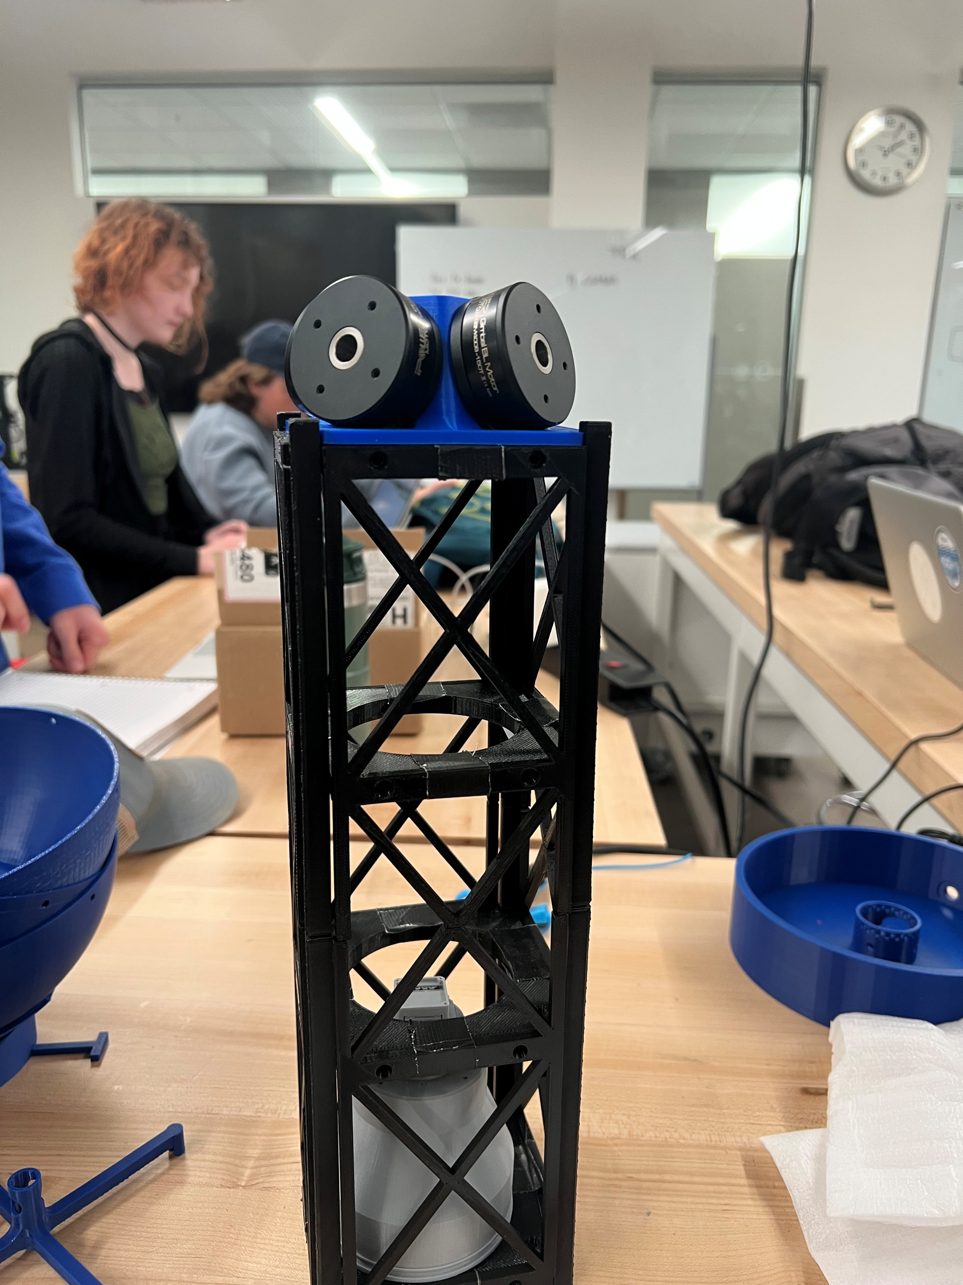
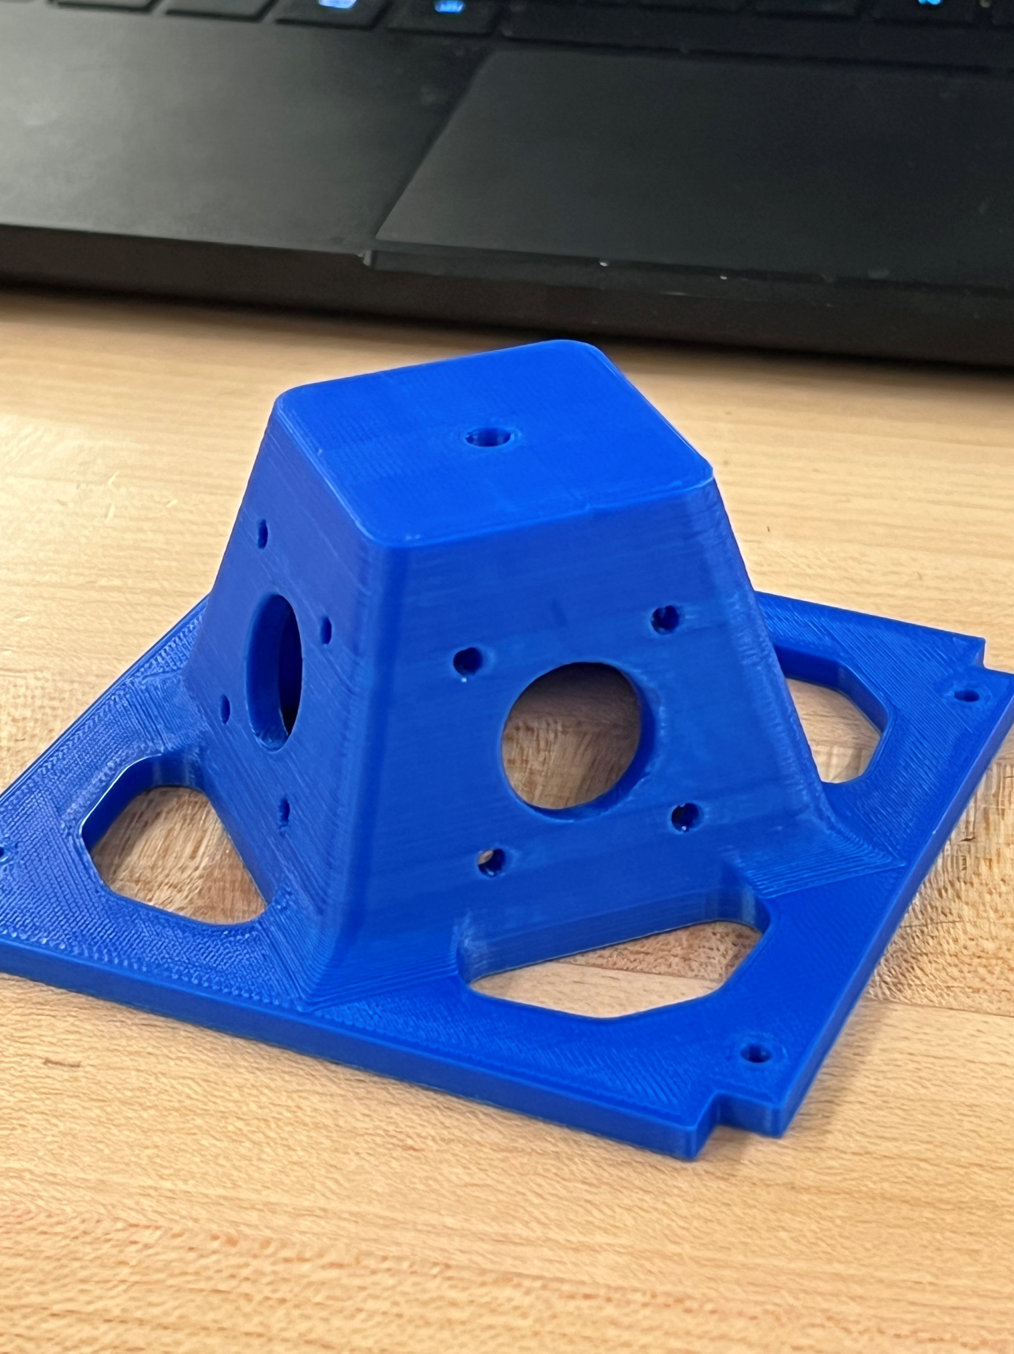
Prototype Completion Check *pictures will include reaction wheel setup and mounted to a 3U prototype

Slide 7
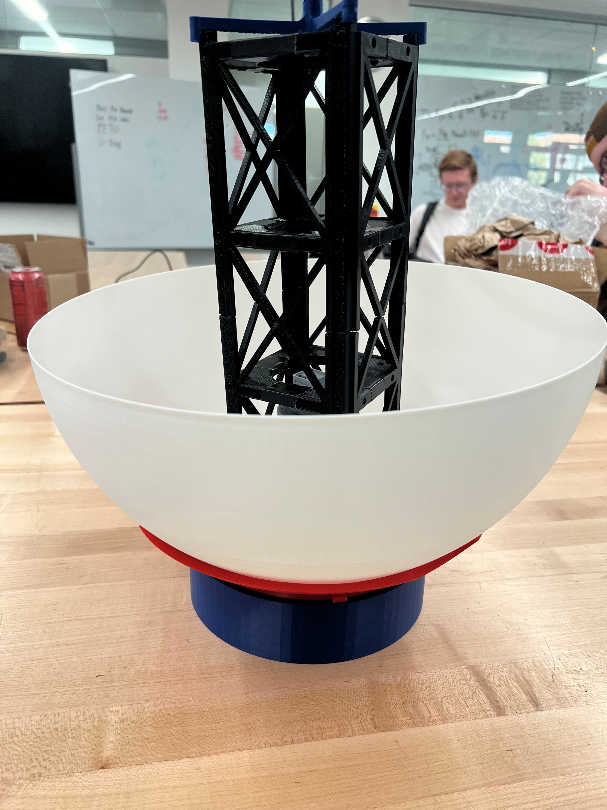
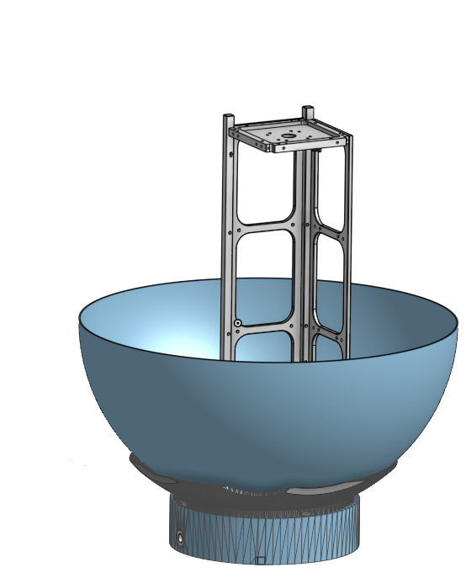
Jigs & Fixtures – Spherical air bearing
Why do we need this test fixture?
Spherical air bearings are used in CubeSat control subsystem testing to simulate frictionless motion in attitude control experiments. These bearings allow CubeSats or other spacecraft models to rotate freely in multiple axes with minimal resistance, closely approximating the microgravity and near-frictionless conditions of space.
The spherical air bearing will help us test out the simulation code that Ben has been writing for the past couple of months.
Most of our testing is going to take place in this fixture.
We are going to test 1-2 metrics for each test that we run.
This is because we have many metrics that we need to test and
doing each one individually can waste a lot of time and we are
starting to run out of time.
Notes:
Notes:
List your talking points with details. You will not read from these notes and these notes may contain information that you forget to mention in your presentation.
Everything needs to be in bullet point form and put in presenting order.

Slide 8
Detailed Test Plan #1
# | Metric | Description | Units | Acceptable Range | Planned Test
1 | Pointing Accuracy | How accurately the attitude and control can be maintainted in a desired direction | rad | 0.00174533 to 0.0174533 | Spherical Bearing
# Tests | 20
Limitations | Since we are using a spherical bearing fixture to test, we have limitations on where we can point it at.
Time/Test | 10 minutes
Total Time | 2 hours
Location | Capstone Room
Test Equipment Needed | Pressure valves, tubing, connectors
Jig/Fixture Required | Yes, using spherical bearing fixture and entire CubeSat.
Test Procedure:
Place CubeSat on spherical air bearing
Run program and determine accuracy using a laser pointer.
We will have it point a different objects and see how accurate we can get it down to.
Statistical Significance:
CubeSat must be able to point accurately to take good imagery.
Notes:
You may add additional information in the notes section
Repeatability:
A detailed test procedure is the best way to ensure test repeatability
Think through small things or seemingly unrelated factors that may influence the results of your test such as
Environmental conditions
Rate of change of any testing variable
Positioning
Resolution of equipment
Statistical Significance
You may talk about factors such as reliability, confidence, etc.
Why are you choosing the number of tests you proposed?
If limited on number of samples, how statistically significant will your results be?

Slide 9
Detailed Test Plan #2
# | Metric | Description | Units | Acceptable Range | Planned Test
2 | Rotate to Fix blur | The CubeSat will need to rotate while taking a picture to stop the blur | rad | 0.288 | Spherical Bearing
# Tests | 20 tests
Limitations | Maybe on how far we can rotate the CubeSat.
Time/Test | 10 minutes
Total Time | 2-3 hours
Location | Capstone room
Test Equipment Needed | Pressure valves, tubing, connectors
Jig/Fixture Required | Yes, using spherical bearing fixture and entire CubeSat.
Test Procedure:
Place on spherical air bearing
Fire up control systems and simulate in-flight maneuvering.
Statistical Significance:
We will need to be capable of tracking ground targets so that the image doesn't blur (camera has a 12 ms exposure time).
Notes:
You may add additional information in the notes section
Repeatability:
A detailed test procedure is the best way to ensure test repeatability
Think through small things or seemingly unrelated factors that may influence the results of your test such as
Environmental conditions
Rate of change of any testing variable
Positioning
Resolution of equipment
Statistical Significance
You may talk about factors such as reliability, confidence, etc.
Why are you choosing the number of tests you proposed?
If limited on number of samples, how statistically significant will your results be?

Slide 10
Detailed Test Plan #3
# | Metric | Description | Units | Acceptable Range | Planned Test
3 | Sun Sensor | Locates the sun and is required to back up star tracker (response time) | ms | <10 | Put it in the sun
# Tests | 20
Limitations | No
Time/Test | 3 minutes
Total Time | 60-90 minutes
Location | Capstone room
Test Equipment Needed | Sun Sensors, Sun
Jig/Fixture Required | CubeSat
Test Procedure:
Place CubeSat under real or simulated sunlight
Determine if CubeSat can determine location of both the Sun and the satellite.
Statistical Significance:
CubeSat must be capable of using the sun sensor for navigation.
Notes:
You may add additional information in the notes section
Repeatability:
A detailed test procedure is the best way to ensure test repeatability
Think through small things or seemingly unrelated factors that may influence the results of your test such as
Environmental conditions
Rate of change of any testing variable
Positioning
Resolution of equipment
Statistical Significance
You may talk about factors such as reliability, confidence, etc.
Why are you choosing the number of tests you proposed?
If limited on number of samples, how statistically significant will your results be?

Slide 11
Detailed Test Plan #4
# | Metric | Description | Units | Acceptable Range | Planned Test
4 | IMU | Tracks acceleration (accuracy) | Gravity force | -16 to 16 | Spherical Bearing (among others)
# Tests | 20
Limitations | No, maybe how fast we can move the CubeSat in the spherical bearing.
Time/Test | 10 minutes
Total Time | 2-3 hours
Location | Capstone room
Test Equipment Needed | Pressure valves, tubing, connectors
Jig/Fixture Required | Yes, using spherical bearing fixture and entire CubeSat.
Test Procedure:
Place entire CubeSat on spherical air bearing.
Maneuver CubeSat and see if the IMU can determine CubeSat's rotation.
Statistical Significance:
CubeSat must be able to use the IMU in order to greatly increase pointing accuracy and responsiveness.
Notes:
You may add additional information in the notes section
Repeatability:
A detailed test procedure is the best way to ensure test repeatability
Think through small things or seemingly unrelated factors that may influence the results of your test such as
Environmental conditions
Rate of change of any testing variable
Positioning
Resolution of equipment
Statistical Significance
You may talk about factors such as reliability, confidence, etc.
Why are you choosing the number of tests you proposed?
If limited on number of samples, how statistically significant will your results be?

Slide 12
Detailed Test Plan #5
# | Metric | Description | Units | Acceptable Range | Planned Test
5 | Magnetometer | Range to cover earths magnetic field | microtesla | 20 to 10000 | Measure magnetic field in the room and cross-check it
# Tests | 20
Limitations | No
Time/Test | 5-10 minutes
Total Time | 2 hours
Location | Capstone Room/Outside
Test Equipment Needed | Magnetometer
Jig/Fixture Required | Maybe just have it mounted to CubeSat
Test Procedure:
Map magnetic field in CubeSat's vicinity
Have the magnetometer measure magnetic field and cross-check it with our data.
Statistical Significance:
An accurate magnetometer is key to ensuring CubeSat redundancy and further improving accuracy.
Notes:
You may add additional information in the notes section
Repeatability:
A detailed test procedure is the best way to ensure test repeatability
Think through small things or seemingly unrelated factors that may influence the results of your test such as
Environmental conditions
Rate of change of any testing variable
Positioning
Resolution of equipment
Statistical Significance
You may talk about factors such as reliability, confidence, etc.
Why are you choosing the number of tests you proposed?
If limited on number of samples, how statistically significant will your results be?

Slide 13
Detailed Test Plan #6
# | Metric | Description | Units | Acceptable Range | Planned Test
6 | Magnetic dipole | Magnetorquers ability to create a magnetic dipole | Am^2 | 0.1 to 10 | Spherical Bearing
# Tests | 20
Limitations | No, we can weight our subsystem components as many times
Time/Test | 15 minutes
Total Time | 2 hours
Location | Capstone room
Test Equipment Needed | Pressure valves, tubing, connectors
Jig/Fixture Required | Yes, using spherical bearing fixture and entire CubeSat.
Test Procedure:
Place CubeSat on spherical air bearing
Measure what reaction the magnetorquers can elicit.
Statistical Significance:
Magnetorquers are used for kinetic energy dumping and parking orbit orientation and are key to ensuring efficiency during these periods.
Notes:
You may add additional information in the notes section
Repeatability:
A detailed test procedure is the best way to ensure test repeatability
Think through small things or seemingly unrelated factors that may influence the results of your test such as
Environmental conditions
Rate of change of any testing variable
Positioning
Resolution of equipment
Statistical Significance
You may talk about factors such as reliability, confidence, etc.
Why are you choosing the number of tests you proposed?
If limited on number of samples, how statistically significant will your results be?

Slide 14
Detailed Test Plan #7
# | Metric | Description | Units | Acceptable Range | Planned Test
7 | FOV | Star Tracker camera | deg | 40 | Ceiling calibration
# Tests | 20
Limitations | No, we can do many different calibration sheets.
Time/Test | 15 minutes
Total Time | 2 hours
Location | Capstone Room
Test Equipment Needed | Star tracker camera and appropriate lens. Calibration Sheet
Jig/Fixture Required | No
Test Procedure:
Place calibration sheet on ceiling
Use the Star Tracker camera with the correct lens.
Use the camera to measure the distance between each set of dots on the calibration sheet, change the resolution for each test until it can do it.
Statistical Significance:
CubeSat will be able to use Star Tracker to navigate and determine its orientation as well as cross-check with other systems.
Notes:
You may add additional information in the notes section
Repeatability:
A detailed test procedure is the best way to ensure test repeatability
Think through small things or seemingly unrelated factors that may influence the results of your test such as
Environmental conditions
Rate of change of any testing variable
Positioning
Resolution of equipment
Statistical Significance
You may talk about factors such as reliability, confidence, etc.
Why are you choosing the number of tests you proposed?
If limited on number of samples, how statistically significant will your results be?

Slide 15
Detailed Test Plan #8
# | Metric | Description | Units | Acceptable Range | Planned Test
8 | Weight | Total Contingency Weight | g | 752.64 | Scale
# Tests | 1
Limitations | No, we can weight our subsystem components as many times
Time/Test | 10-60 seconds
Total Time | 2 minutes
Location | Shop Classroom
Test Equipment Needed | Scale
Jig/Fixture Required | All Control Fixtures
Test Procedure:
Gather all of the control subsystem components that are going to be mounted for the CubeSat.
Assemble all the components and weigh them on the scale. Or we can do each one individually.
Statistical Significance:
We have a restriction on how much our subsystem can weigh. It is important to know the total weight of our entire subsystem so that we are not over the acceptable range.
Notes:
You may add additional information in the notes section
Repeatability:
A detailed test procedure is the best way to ensure test repeatability
Think through small things or seemingly unrelated factors that may influence the results of your test such as
Environmental conditions
Rate of change of any testing variable
Positioning
Resolution of equipment
Statistical Significance
You may talk about factors such as reliability, confidence, etc.
Why are you choosing the number of tests you proposed?
If limited on number of samples, how statistically significant will your results be?

Slide 16
Detailed Test Plan #9
# | Metric | Description | Units | Acceptable Range | Planned Test
9 | Rotating Accuracy | How accurately the cubesat is able to rotate | mrad | 0.1 to 1 | Spherical Bearing
# Tests | 20
Limitations | No, we shouldn’t have any.
Time/Test | 10 minutes
Total Time | 2 hours
Location | Capstone room
Test Equipment Needed | Pressure valves, tubing, connectors
Jig/Fixture Required | Yes, using spherical bearing fixture and entire CubeSat.
Test Procedure:
Place CubeSat on spherical air bearing
Run program and determine ability to initiate and terminate rotation with as little oscillation as possible.
Statistical Significance:
Ability to rotate and negate oscillation could determine CubeSat's ability to complete its mission.
Notes:
You may add additional information in the notes section
Repeatability:
A detailed test procedure is the best way to ensure test repeatability
Think through small things or seemingly unrelated factors that may influence the results of your test such as
Environmental conditions
Rate of change of any testing variable
Positioning
Resolution of equipment
Statistical Significance
You may talk about factors such as reliability, confidence, etc.
Why are you choosing the number of tests you proposed?
If limited on number of samples, how statistically significant will your results be?

Slide 17
Detailed Test Plan #10
# | Metric | Description | Units | Acceptable Range | Planned Test
10 | Power Consumption | How power is required for the entire subsystem | Watts | <13 | Spin-up motors
# Tests | 1-2 tests, don't want to damage hardware.
Limitations | Yes, make sure we don't go over max power for the components.
Time/Test | 5-10 seconds, don't want to possibly damage the equipment
Total Time | 3 minutes
Location | Capstone room.
Test Equipment Needed | Power Supply
Jig/Fixture Required | All electronic components
Test Procedure:
Spin up reaction control wheel motors at maximum power to determine power consumption at different speeds.
Statistical Significance:
We must be able to provide an accurate estimate of what power the reaction control wheel motor consume to budget electricity to other systems.
Notes:
You may add additional information in the notes section
Repeatability:
A detailed test procedure is the best way to ensure test repeatability
Think through small things or seemingly unrelated factors that may influence the results of your test such as
Environmental conditions
Rate of change of any testing variable
Positioning
Resolution of equipment
Statistical Significance
You may talk about factors such as reliability, confidence, etc.
Why are you choosing the number of tests you proposed?
If limited on number of samples, how statistically significant will your results be?

Slide 18
Detailed Test Plan #11
# | Metric | Description | Units | Acceptable Range | Planned Test
11 | Budget | Budget for the Control Subsystem | $ | <1500 | Spend Wisely
# Tests | One test
Limitations | Don't go over budget
Time/Test | N/A
Total Time | N/A
Location | Capstone or Anywhere
Test Equipment Needed | Computer
Jig/Fixture Required | No
Test Procedure:
Keep track of Control spendings and take measures to keep costs within feasible limits.
Statistical Significance:
CubeSat must remain within budget and we must keep track of projected costs.
Notes:
You may add additional information in the notes section
Repeatability:
A detailed test procedure is the best way to ensure test repeatability
Think through small things or seemingly unrelated factors that may influence the results of your test such as
Environmental conditions
Rate of change of any testing variable
Positioning
Resolution of equipment
Statistical Significance
You may talk about factors such as reliability, confidence, etc.
Why are you choosing the number of tests you proposed?
If limited on number of samples, how statistically significant will your results be?

Slide 19
Detailed Test Plan #12
# | Metric | Description | Units | Acceptable Range | Planned Test
14 | Angular Velocity (Rotating) | How fast cubesat will need to move to complete rotation to take picture | rad/s | 0.01 to 0.1 | Spherical Bearing
# Tests | 5
Limitations | No
Time/Test | 1 hour
Total Time | 5 hours
Location | Capstone Room
Test Equipment Needed | Pressure valves, tubing, connectors
Jig/Fixture Required | Yes, using spherical bearing fixture and entire CubeSat.
Test Procedure:
Determine what angular rates CubeSat will need to rotate at to track ground targets
Place CubeSat on spherical air bearing
Run program and determine accuracy and whether or not CubeSat can maintain desired rates accurately.
Statistical Significance:
CubeSat must be able to track ground targets accurately.
Notes:
You may add additional information in the notes section
Repeatability:
A detailed test procedure is the best way to ensure test repeatability
Think through small things or seemingly unrelated factors that may influence the results of your test such as
Environmental conditions
Rate of change of any testing variable
Positioning
Resolution of equipment
Statistical Significance
You may talk about factors such as reliability, confidence, etc.
Why are you choosing the number of tests you proposed?
If limited on number of samples, how statistically significant will your results be?

Slide 20
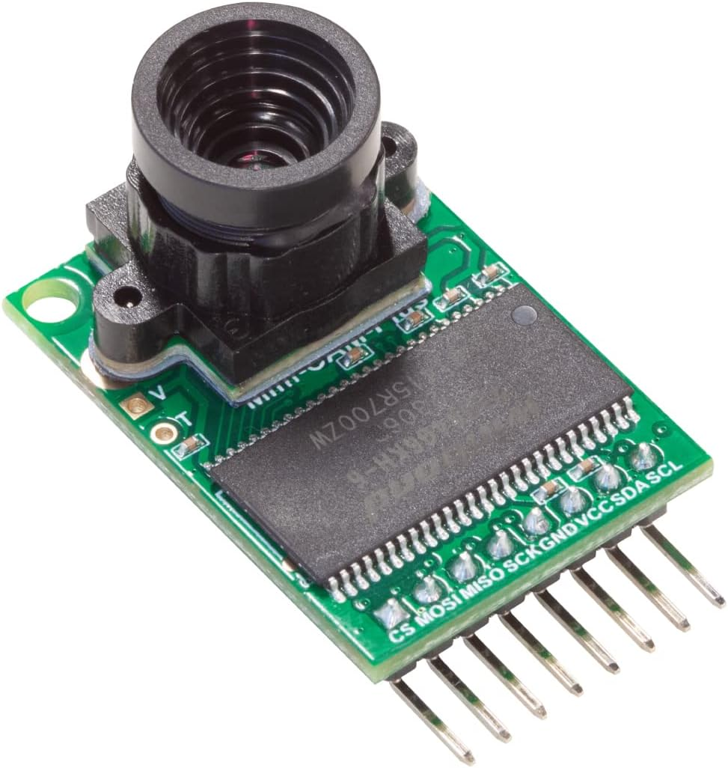
Calibration
The one thing that we need to calibrate with our subsystem is the star tracker camera. Specifically, calibrating the camera's resolution.
Step-by-step plan on calibrating:
Write out a Matlab code that creates a grid of dots.
Create different pdfs, changing the lengths between each dot.
Have the camera measure and see if it can recognize the distance between each of the dots to. This will help with calibrating the resolution
Talking Points:
Describe your calibration plan and requirements for calibration.
Notes:
Notes:
List your talking points with details. You will not read from these notes and these notes may contain information that you forget to mention in your presentation.
Everything needs to be in bullet point form and put in presenting order.

Slide 21
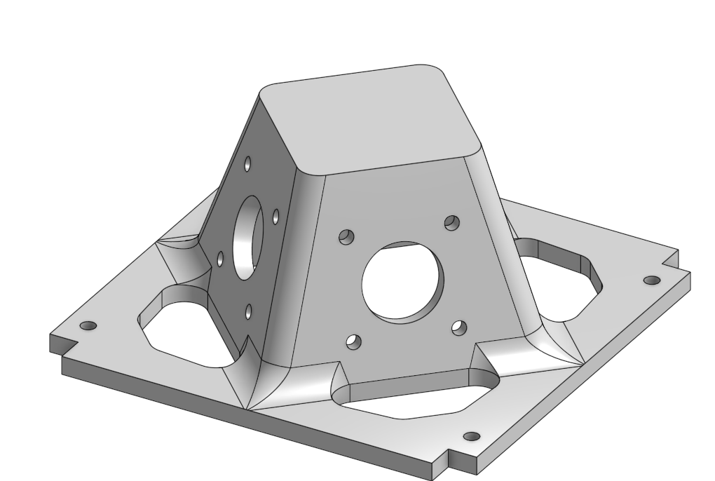
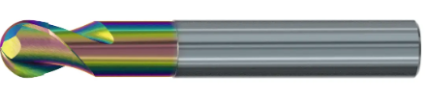
Fabrication Plan
Jig / Fixture | Process(es) Required for Fabrication | Costs
Reaction Wheel Mount (Have met with Professor Schiller to machine this component) | CNC Mill Manual Mill | Aluminum Stock = $46.50 Custom Tooling = $186.36 CNC Mill time = 6 hours
Notes:
Notes:
List your talking points with details. You will not read from these notes and these notes may contain information that you forget to mention in your presentation.
Everything needs to be in bullet point form and put in presenting order.

Slide 22
Bill of Materials
Link to Bill of Materials for testing

Slide 23
Budget
Category | PDR Budget | CDR Expenses | Test Readiness Expenses
Materials & Supplies | $376.42 | $376.42 | $629.90
Tooling & Machining | $150.00 | $150.00 | $150.00
Testing | $162.00 | $162.00 | $192.35
Contingency | $1,013.54 | $1,013.54 | $1,166.70
TOTAL | $844.62 | $844.62 | $972.45

Slide 24
Schedule
Schedule via Gantt Chart:
Milestones
Test Results Review
Improvement Review
Final Review
Exhibition (Design Day)
Delta CDR
Notes:
Notes:
List your talking points with details. You will not read from these notes and these notes may contain information that you forget to mention in your presentation.
Everything needs to be in bullet point form and put in presenting order.

Slide 25
Questions

